Slide 1
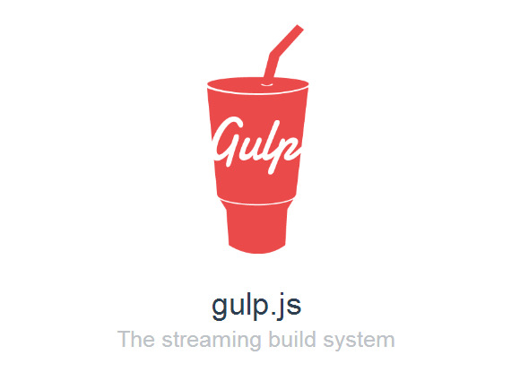
Gulp.js Introduction
A brief overview of the four functions available in the Gulp API and how to use them, and Gulp plugins to aid your web development workflow.
http: //gulpjs.com
Notes:
https://www.youtube.com/watch?v=dwSLFai8ovQ
https://scotch.io/tutorials/automate-your-tasks-easily-with-gulp-js

Slide 2
Mike Hamilton
Senior Consultant, Neudesic, @mikescott8 Founder & Co-Organizer, NWVDNUG (Northwest Valley .Net User Group), @nwvdnug

Slide 3
Requirements
Node/NPM
Gulp.js
Editor/IDE
Command line
Need Node installed so that you have NPM (Node Package Manager).
NPM is used to install Gulp.Js and plugins for Gulp processing.
Gulp uses Node’s Require for dependencies.
After Node is installed, at a command prompt in directory for project type:
npm install --global gulp npm init npm install –save-dev gulp
Any editor or IDE is fine. For this I will be using VS Code.
Command line or shell prompt. Gulp tasks are run from command line (or from editor/IDE if supported).

Slide 4
The four top level functions of gulp
Gulp.Task
Gulp.Src
Gulp.Dest
Gulp.watch
Used to create your tasks.
It takes the following parameters:
name - string
deps – array of task names - OPTIONAL
fn – the function that is the task
Tells what files to use.
Parameters are:
glob - *
options object – OPTIONAL
Uses .pipe to chaining it’s output to other plugins.
Tells Gulp the output folder to write to.
Used primarily to run tasks when files change.
Pass into it:
glob
options object – OPTIONAL
Array of tasks to run OR callback function
* - “In computer programming, in particular in a Unix-like environment, glob patterns specify sets of filenames with wildcard characters.”
Notes:
https://en.wikipedia.org/wiki/Glob_(programming)

Slide 5
demo
Show us gulp doing some stuff!

Slide 6
done
Watch https://mikescott8.wordpress.com/ for blog post with link to this slide deck and other useful links and Github repo.

